Slide 1
🎯Welcome to Build With AI 2.0!🚀 💡Let’s Learn, Build & Innovate Together!🚀
On Campus SVIT, Vasad

Slide 2

Flutter x Gemini
A Hands-On Seminar for Beginners

Slide 3
Agenda
Introduction to Flutter
API vs Packages
Project Setup
Basics
Package Integration
Hand-on Session
Q&A and Next Steps

Slide 4
01
What is Flutter?
Notes:
open-source UI toolkit developed by Google, to build natively compiled applications for mobile (Android & iOS), web, and desktop from a single codebase.

Slide 5
Key Features
Cross-platform
Efficient
Hot Reload
Single codebase for all
(iOS, Android, Web, Desktop)
natively compiled applications
Fast development with hot reload

Slide 6
02
APIs vs Packages

Slide 7
APIs vs Packages
API | Packages
A set of rules for communication between applications | A pre-built library that simplifies interaction with an API or service.
You manually write code to make HTTP requests and handle responses | You use pre-built functions provided by the package.
Requires more code and error handling (e.g., HTTP status codes). | Abstracts complexity, making it easier to use.
e.g. Fetching data from Gemini API by making http requests | e.g. Using google_generative_ai package to interact with Google’s AI

Slide 8
03
Setting Up the Flutter Project

Slide 9
Setting Up the Flutter Project
Creating a new Flutter project
Project structure overview
pubspec.yaml: Manages dependencies and assets.
android and ios: Platform-specific code.
test: For writing tests.
lib: Contains the main Dart code, we’ll work mainly in the lib folder.

Slide 10
04
UI Basics & State Management

Slide 11
UI Basics
Everything in Flutter is a widget (Text, Button, Image, etc.).
Widgets are composable – you can nest them to create complex layouts.
Two types of widgets:
StatelessWidget (UI doesn’t change)
StatefulWidget (UI changes dynamically)

Slide 12
State Management
State = Data that can change in an app
Common state management approaches:
setState()
Provider, Riverpod, BLoC

Slide 13
05
Packages

Slide 14
Packages
What are Flutter packages?
Where to find packages? pub.dev
Commonly used packages
How to install a package
Run flutter pub get to install
Notes:
Flutter packages are reusable libraries that extend the functionality of Flutter apps. They allow developers to add features like API calls, state management, animations, and database access without writing everything from scratch.

Slide 15

06
Coding the App

Slide 16
Coding the App
Home Screen
Input Field – Add a TextField for user input
Chat Bubbles – Display messages in a ListView
Gemini Integration – Send messages and display AI responses
Clearing the History - if time permits (DIY Session)
Alternate Way of Integrating Gemini - if time permits

Slide 17
07
Testing & Debugging

Slide 18
Testing & Debugging
Use print() to check values.
Handle errors with try-catch to prevent crashes.
Use Flutter DevTools to inspect UI and logs.

Slide 19
Thanks!
Any Questions?

Slide 20
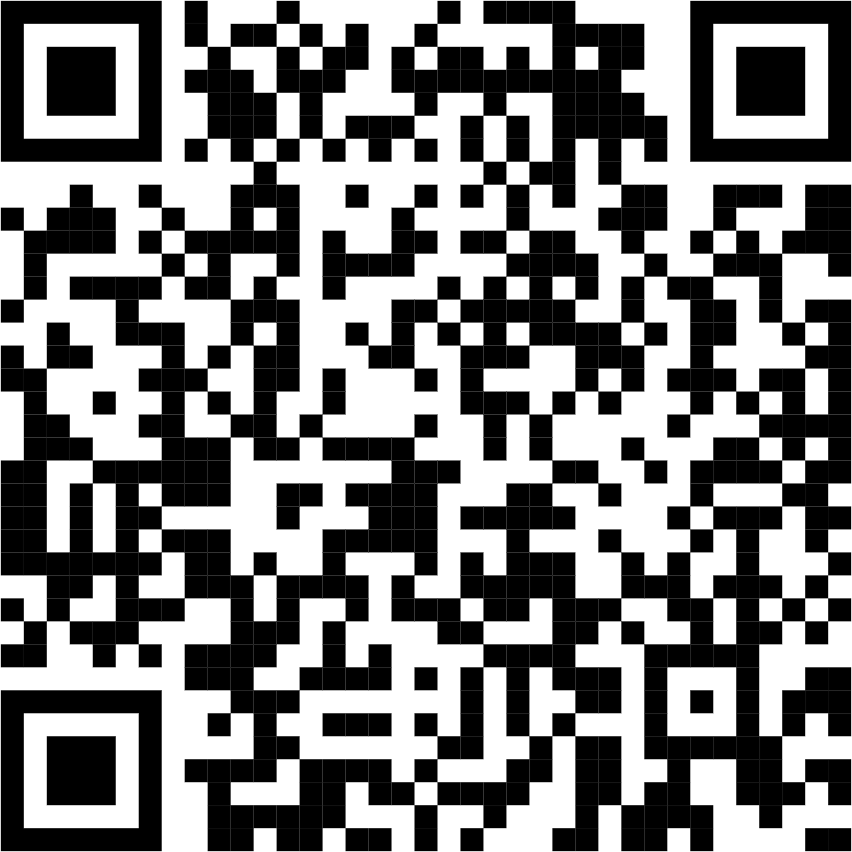
💡We’d love to hear your thoughts!
On Campus SVIT, Vasad
Thank You for Attending Build With AI 2.0! 🚀

